Slide 1




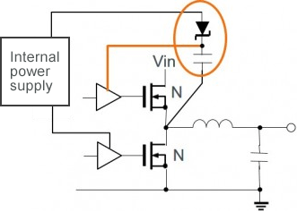
Electrical
Power Supply and Switching
04/09/21
Kemal Pulungan
Technical Updates
Received advice from James Phillips regarding circuit
In its current state, the MOSFETs would fail
Recommends bootstrap circuitry for switching high voltages, which I am reading up on to put in the circuit.
Circuit Board for Electronics – Discussed how to design it (KiCAD), standards for doing so (IPC-2221), and safety working with high voltage. Still need to implement bootstrap circuitry to finish design

Slide 2
Electrical
Power Supply and Switching
04/09/21
Kemal Pulungan
Work Plan
4-9 to 4-16: Finishing bootstrap circuitry and PCB design
4-16 to 4-23,30: Overseeing construction of the first board (will not be in-person)
Afterwards up to mid-May: Testing of electronics

Slide 3
Electrical
Power Supply and Switching
04/09/21
Kemal Pulungan
Budget
Around $1000, maximum $2000 for one electronics box
Current list below, still subject to changes from James’s recommendations:
https://docs.google.com/document/d/1OB4kSlLJixkQM1dVFev7hlX4f0RqRDF6c5C8Sh-qFfM/edit

